Slide 1
Session 1 – ENC Conversion (sub)WG meeting Oct 7th 2020
Agenda
Welcome
TORs
Where are we?
Workplan
How do we work?
Next Meetings, Actions
Guidance for TORs:
Develop rules for HOs on addressing ENC inconsistencies in data before conversion. Engage with KHOA on lessons learn from their trial.
Produce encoding guidance for HOs that will assist the automation of the conversion process. We must have some real world examples that have been proven to reduce manual processing
Encoding must be tested to ensure it does not adversely affect existing ENC display in ECDIS.

Slide 2
Where are we?
Tools
NIWC viewer works with FC and PC
Caris composer contains mapping engine, tested for S-64 unencrypted test datasets
Github for this subWG (https://github.com/iic-tech/enc_conv)
Schemas
IHO Schema in progress but good enough to make test datasets. Missing a number of relationships. PC allows for initial creation of S-164 screenshots
Test Data
Initial (Phase 1)S-64 test datasets available for review/update (https://github.com/iic-tech/S-164). Also contains text dumps of contents.
No systematic / exhaustive test datasets (yet)
KHOA test datasets also available (earlier release)
Others available (Null Island, Edge Cases) – not in github yet.
Guidance
Documentation from IHO (Jeff), Spreadsheet of modifications to features, attributes, primitives etc…
FC contains existing acronyms ( good for identifying dictionary conversions)
Report (IIC) outlines methodology but no tools currently exist to support
Initial edge case list (JP) in github
Testing and development in progress
No recommended migration methodology

Slide 3
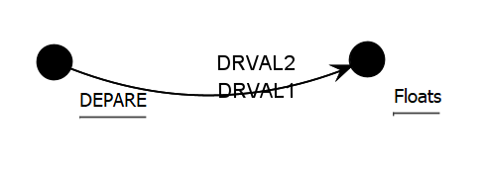
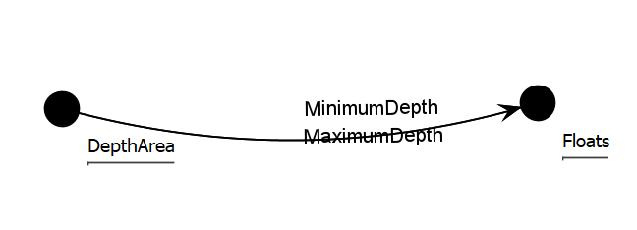
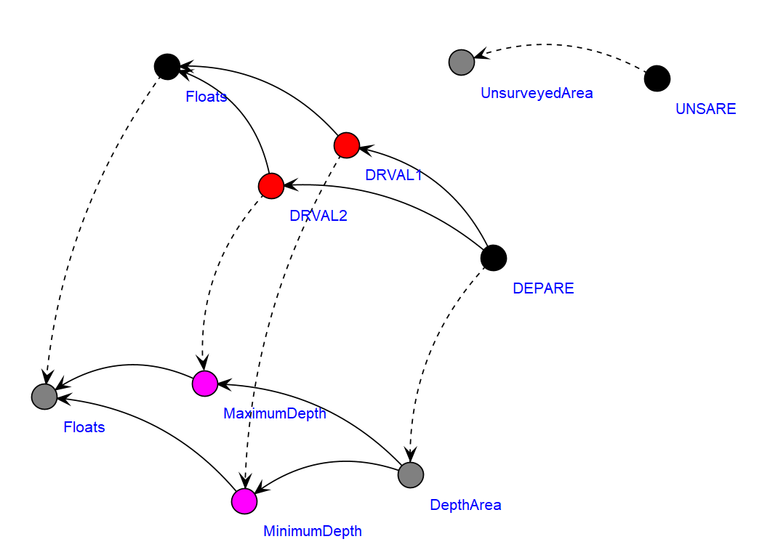
Types of Conversion
Simple dictionary conversion
Where feature and attribute bindings don’t change and are just re-labelled
Mapping from feature->feature and attribute->attribute
80% of content (?) of current ENCs
Edge Cases
Use INFORM to control what is being defined/populated
Geometric primitives which have changed/dropped
Changes to enumerations / meanings
New/Dropped features
Relationships
Special considerations
Hazards / Alerts features
Where portrayal may be different
Where manual intervention may be required
UPDATES

